Slide 1


Redux
Origins
The history behind the popular library
Israel Zablianov, Fed @ Premium

Slide 2
History?
Why bother?
History doesn’t stay behind us.
Studying history helps us understand how events in the past made things the way they are today.
With lessons from the past, we not only learn about how things came to be,
but also develop the ability to avoid mistakes and create better paths for ourselves.
- mooc blog team -

Slide 3
Draft short description
Redux has changed the way modern UI applications are built. But is it a new concept? Or maybe it's been there all along? Join us as we answer this question and learn more about Redux's history! Our session will include the following topics:
What were the alternatives before Redux
Bidirectional vs Unidirectional data flow
The relationship between MVC, Flux and Redux

Slide 4

History?
Why bother?
History doesn’t stay behind us.
Studying history helps us understand how events in the past made things the way they are today.
With lessons from the past, we not only learn about how things came to be,
but also develop the ability to avoid mistakes and create better paths for ourselves.
- mooc blog team -

Slide 5
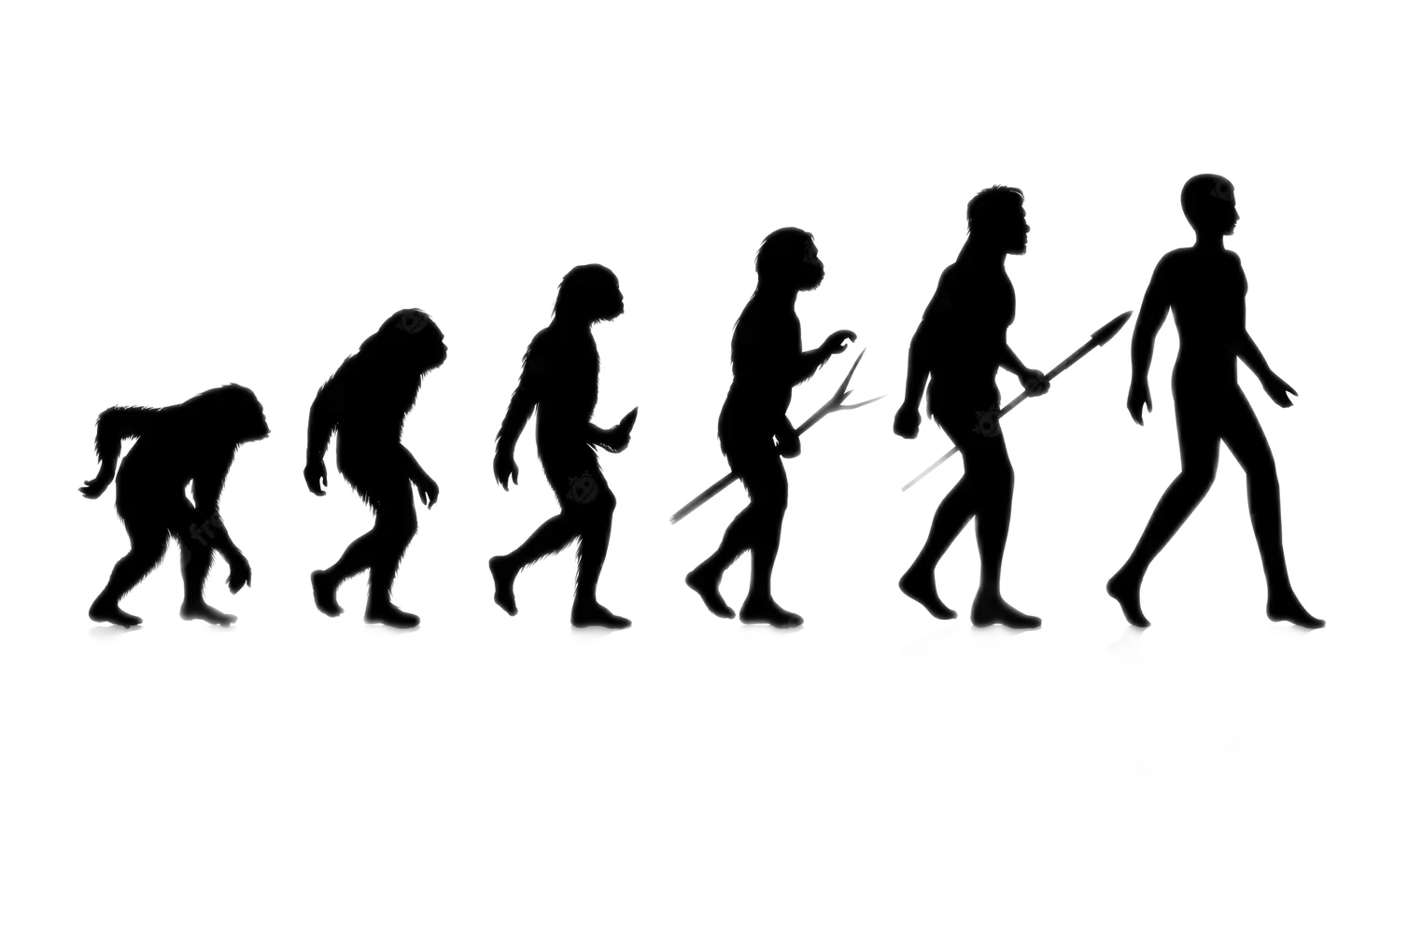


The Evolution of
UI Architecture
MVC
Flux
Redux
C
V
M

Slide 6

Today’s
Agenda
→ What were the alternatives
before Redux
→ Bidirectional VS Unidirectional
data flow
→ The relationship between MVC,
Flux and Redux

Slide 7
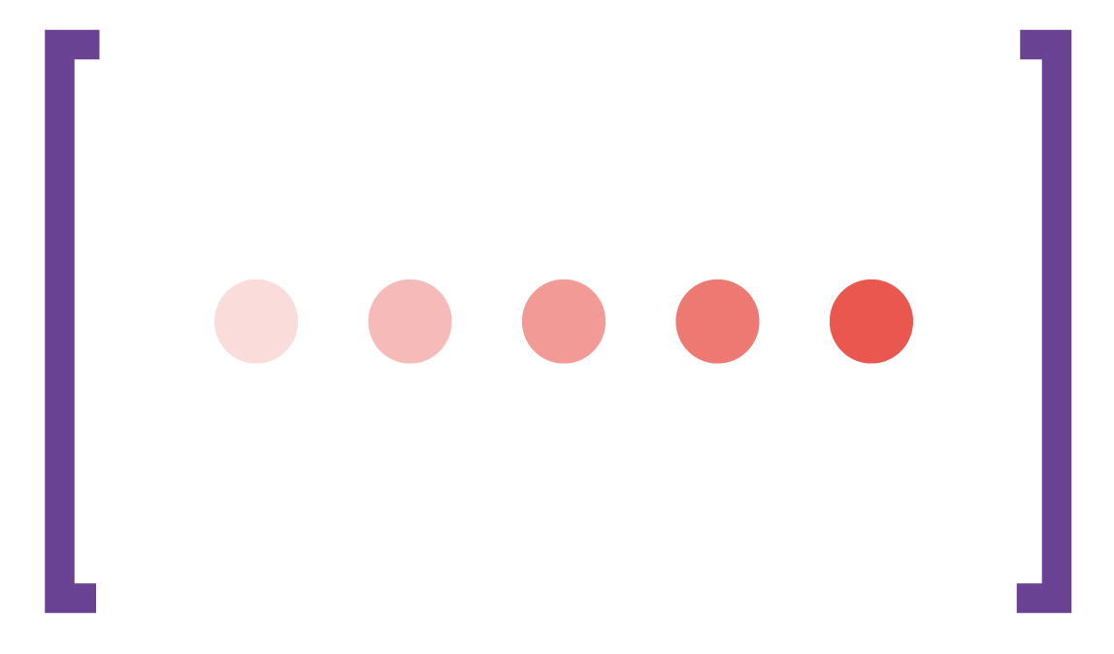
Redux has changed the way modern UI applications are built
But is it a new concept?
Or maybe it's been there all along?

Slide 8

MVC
In 1979, Trygve Reenskaug introduced to the world the MVC pattern.
A software architectural pattern that separates an application into three main logical components - Model View Controller.
Data synchronization and updates are handled by the observer pattern.
Trygve Reenskaug
The creator of MVC
Born – June 21, 1930

Slide 9
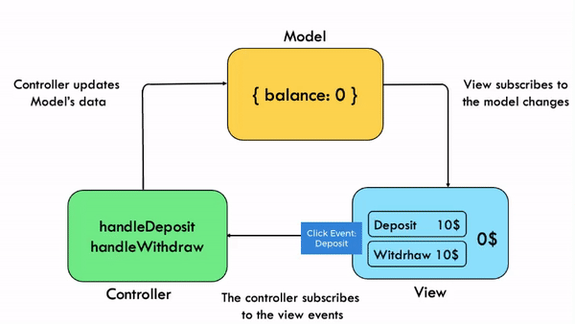
Model –
Responsible for managing application domain data
View –
Responsible for rendering a UI presentation of the model
Controller –
Responsible for handling user input
MVC

Slide 10
Model –
Responsible for managing application domain data
View –
Responsible for rendering a UI presentation of the model
Controller –
Responsible for handling user input
MVC
Model
{ balance: 0 }
{ balance: 10 }
Controller updates Model’s data
Balance Changed
View subscribes to
the model changes
Set Balance
handleDeposit
handleWithdraw
Click Event: Deposit
Deposit 10$
1
0$
$ 10
Witdrhaw 10$
Controller
The controller subscribes
to the view events
View

Slide 11
Sounds great!
So, what’s the
problem?

Slide 12
Sounds great right?
There is only one small problem

Slide 13
MVC doesn’t scale
According to Facebook, MVC is based on the concept of ‘bidirectional data flow’ also known as ‘two way data binding’ and therefore - MVC doesn’t scale

Slide 14


What Is Bidirectional Data Flow?
Angular.JS
Vue.JS
Bidirectional data flow refers to data being changed in multiple directions. In MVC, it usually refers to the view being able to change the model and vice versa.
“Two-way data binding refers to sharing data between a component class and its template.
If you change data in one place, it will automatically reflate at the other end.
For example, if you change the value of the input box, then it will also update the value of the attached property in a component class.”
Model
View
- Tutorialsteacher -

Slide 15
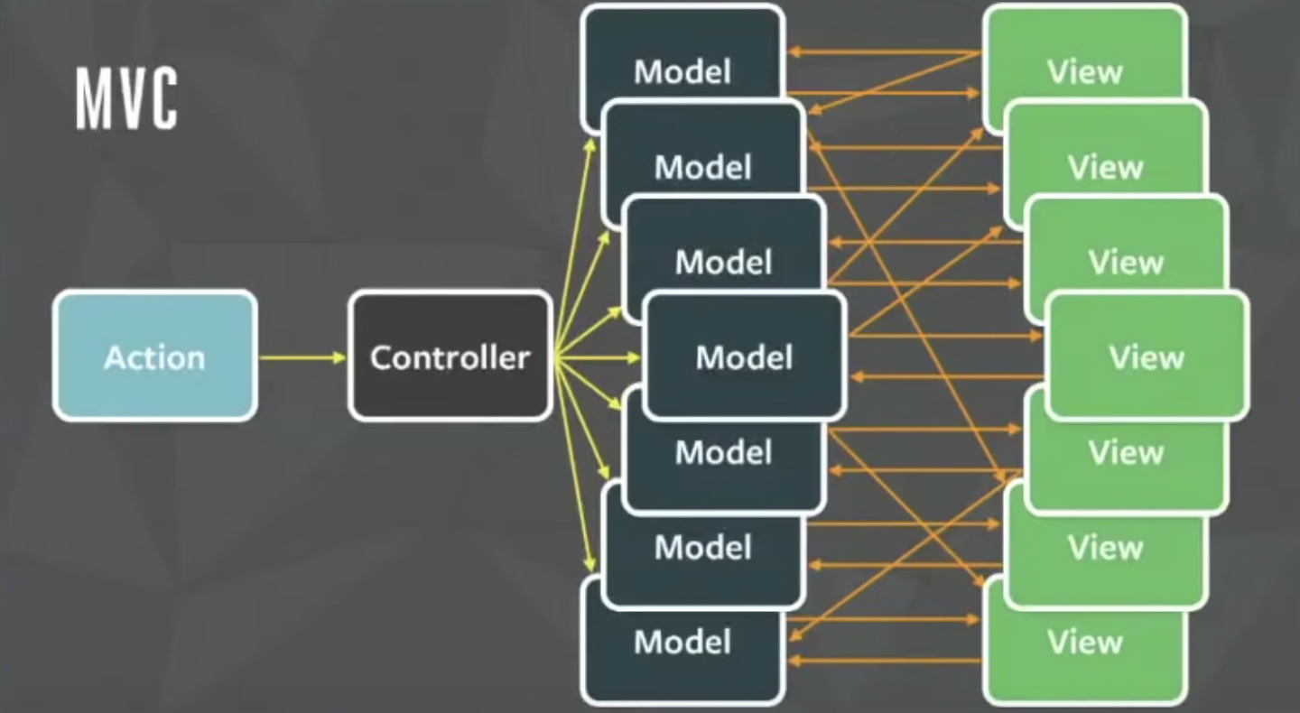
Why Bidirectional Data Flow Is Not Scalable?
An architecture diagram for one of Facebook’s more complex interfaces.
Bidirectional data flow involves many-to-many relationships, which are difficult to track and maintain.
“There is just an explosion of arrows, and if you just look at these arrows, can you tell if there is an infinite loop here?”
Hacker Way: Rethinking Web App Development at Facebook
- Jing Chen -

Slide 16
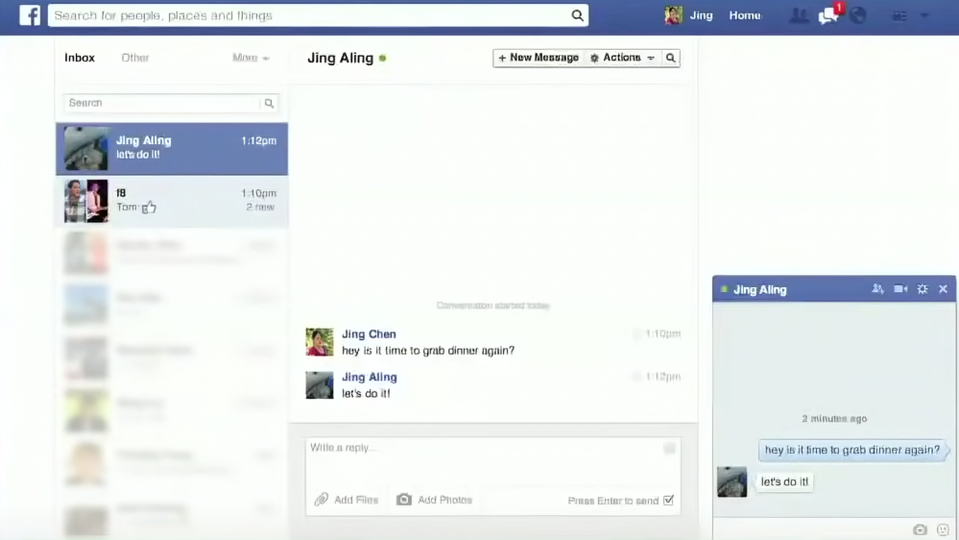
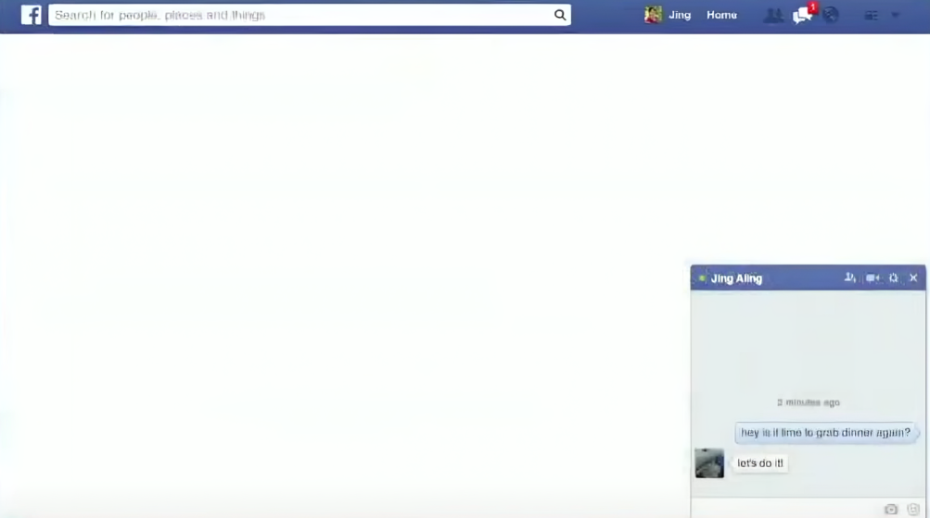

The Unseen Counter
Facebook’s Chat
The unseen count was showing even if there were no unseen messages.
As new features were added to the chat, the bug has returned with a new edge case.

Slide 17
Large-scale applications cannot be built with MVC
A New Architecture Is Needed

Slide 18
Flux
An Alternative To MVC

Slide 19

Flux
In 2014, during the Hacker-Way conference, Facebook introduced Flux architecture as an alternative to MVC.
The main concept of flux is unidirectional data flow
Data synchronization and updates are handled by the observer pattern.
Flux
“Flux is the application architecture that Facebook uses for building client-side web applications.”
- Flux docs -

Slide 20
Flux
Action
Flux
Action
Dispatcher
Store
View
“Flux is the application architecture that Facebook uses for building client-side web applications.”
There is another action node in the diagram,
accounting for actions that do not originate from views, which is common
- Flux docs -

Slide 21
Flux
Flux
View diapatches
actions
Action
View
View subscribes to
the store changes
“Flux is the application architecture that Facebook uses for building client-side web applications.”
Changed Data
Dispatcher
Action
Store
Store subscribes to
Dispatcher events
- Flux docs -

Slide 22
Action
Flux
Store
View
Dispatcher
Action
Actions define the internal API of your application
They are simple objects that have a "type" field and some data
Action
“Flux is a pattern for managing data flow in your application. The most important concept is that data flows in one direction.”
For example, delete todo action:
{
type: 'delete-todo’,
todoID: '1234',
}
- Flux docs -

Slide 23
Action
Flux
Store
View
Dispatcher
Dispatcher
Stores are registering with the dispatcher
The dispatcher receives actions and dispatches them to stores
Every store will receive every action
Action
“Flux is a pattern for managing data flow in your application. The most important concept is that data flows in one direction.”
- Flux docs -

Slide 24
Action
Flux
Store
View
Dispatcher
Store
A store is what holds the data of an application
The data in a store must only be mutated by responding to an action
Every time a store's data changes it must emit a "change" event
Action
“Flux is a pattern for managing data flow in your application. The most important concept is that data flows in one direction.”
- Flux docs -

Slide 25
Action
Flux
Store
View
Dispatcher
View
Data from stores is displayed in views
View subscribes to change events from stores
Actions are typically dispatched from views
Action
“Flux is a pattern for managing data flow in your application. The most important concept is that data flows in one direction.”
- Flux docs -

Slide 26
Action
Flux
Store
View
Dispatcher
Unidirectional data flow
Views send actions to the dispatcher
The dispatcher sends actions to every store
Stores send data to the views
Action
“Flux is a pattern for managing data flow in your application. The most important concept is that data flows in one direction.”
- Flux docs -

Slide 27

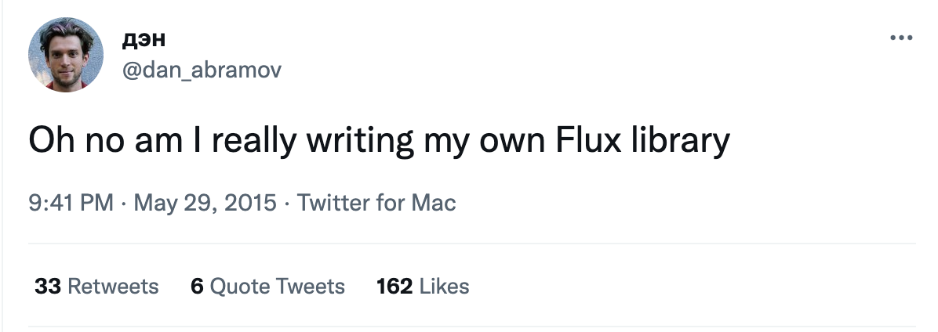

Slide 28

Redux
In 2015, a year after Flux announcement,
Dan Abramov released Redux,
a new implementation of Flux architecture.
Redux
“Redux is a predictable state container for JavaScript apps”
- Redux docs -

Slide 29
Redux
When Redux was introduced, the main differences
from Flux implementations were:
A store is a reducer function
A single source of truth
Immutability
Redux
“Redux is a predictable state container for JavaScript apps”
- Redux docs -

Slide 30

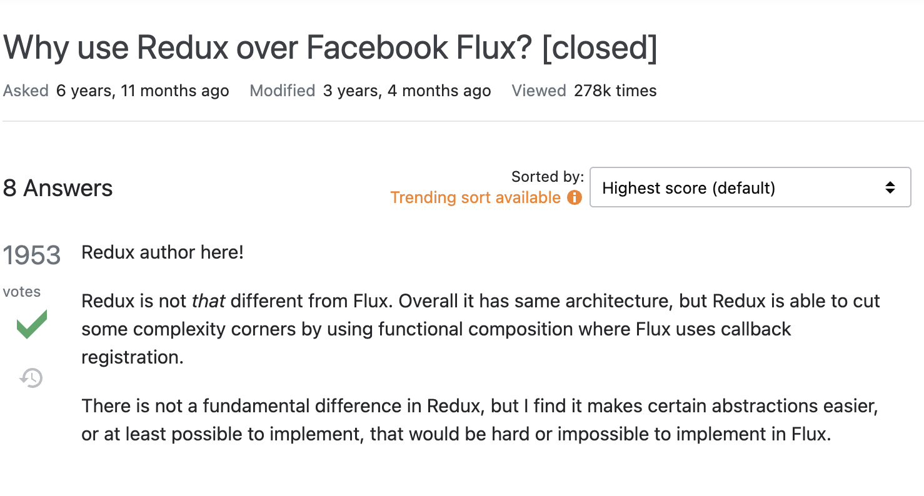

Slide 31
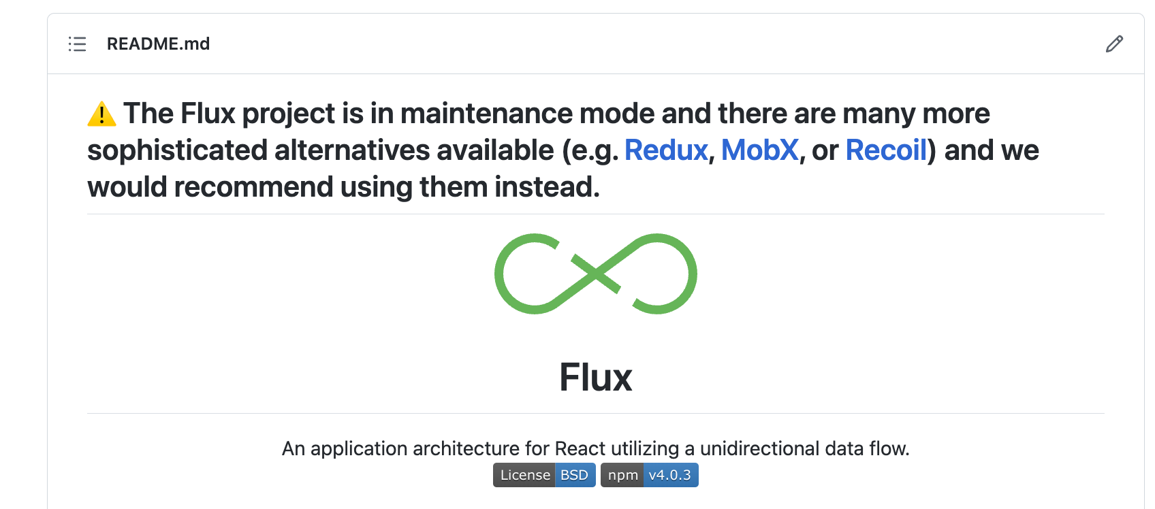
Redux
Redux
“Redux is a predictable state container for JavaScript apps”
- Redux docs -

Slide 32
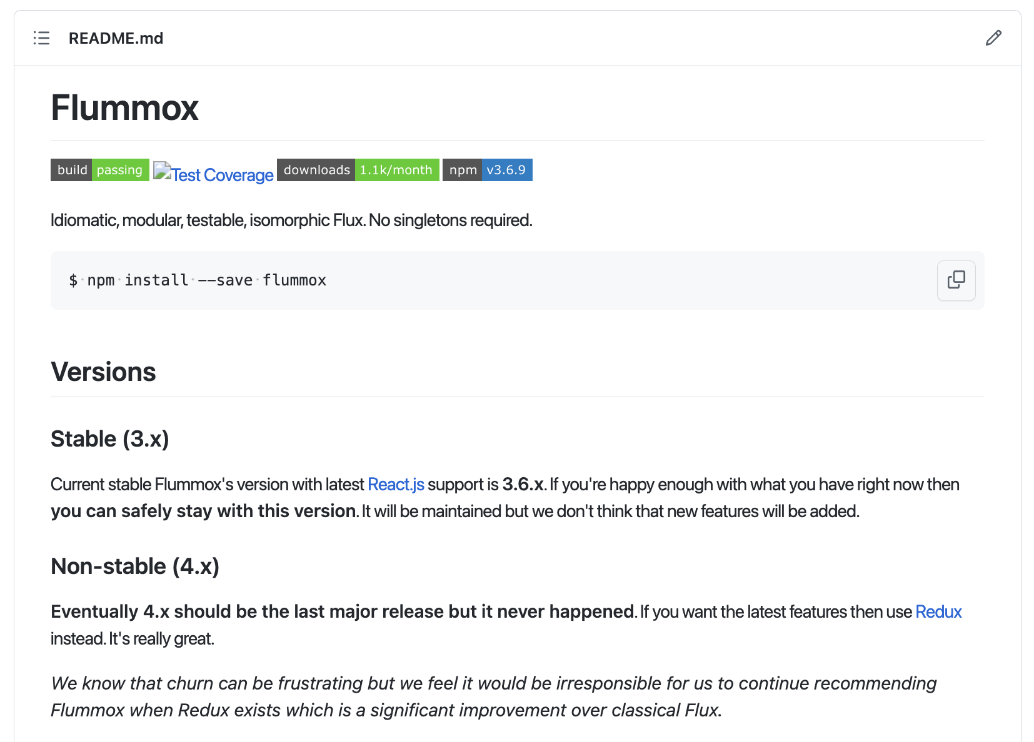
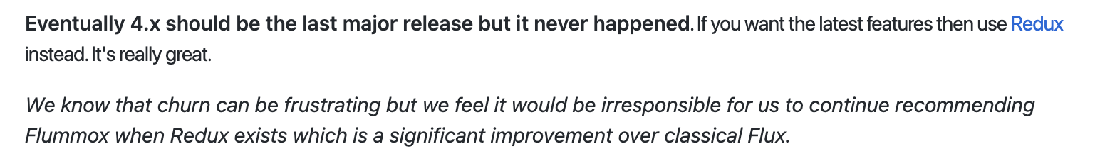
Redux
Redux
“Redux is a predictable state container for JavaScript apps”
- Redux docs -

Slide 33

WAIT A SECOND…

Slide 34
How Did Facebook Use MVC?
Model
View
Model
View
Model
Model
View
Action
Controller
Model
View
Model
View
Controller
View
Model
View
Model
View

Slide 35

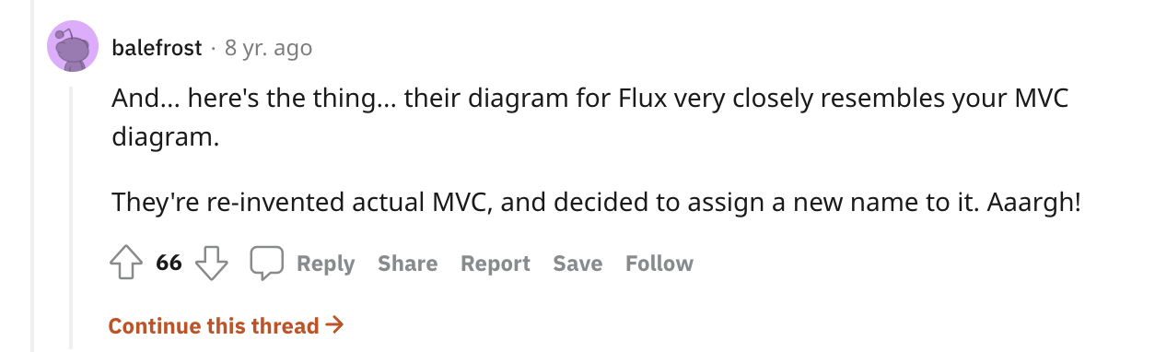
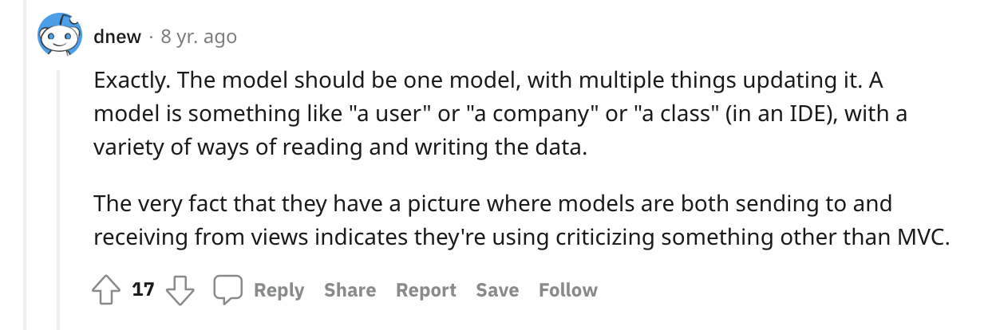

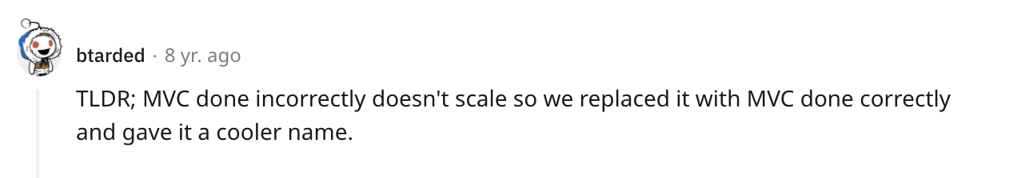
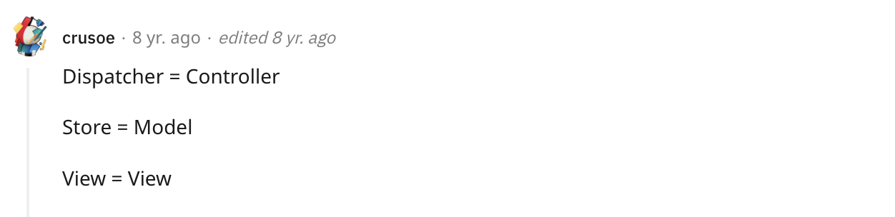
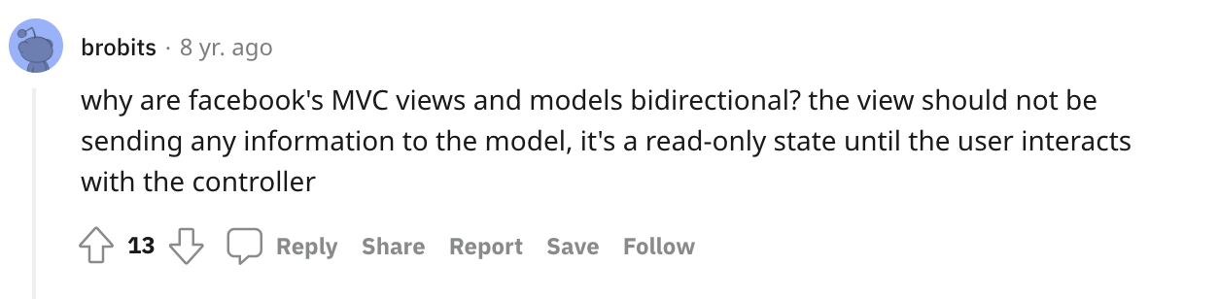

Slide 36
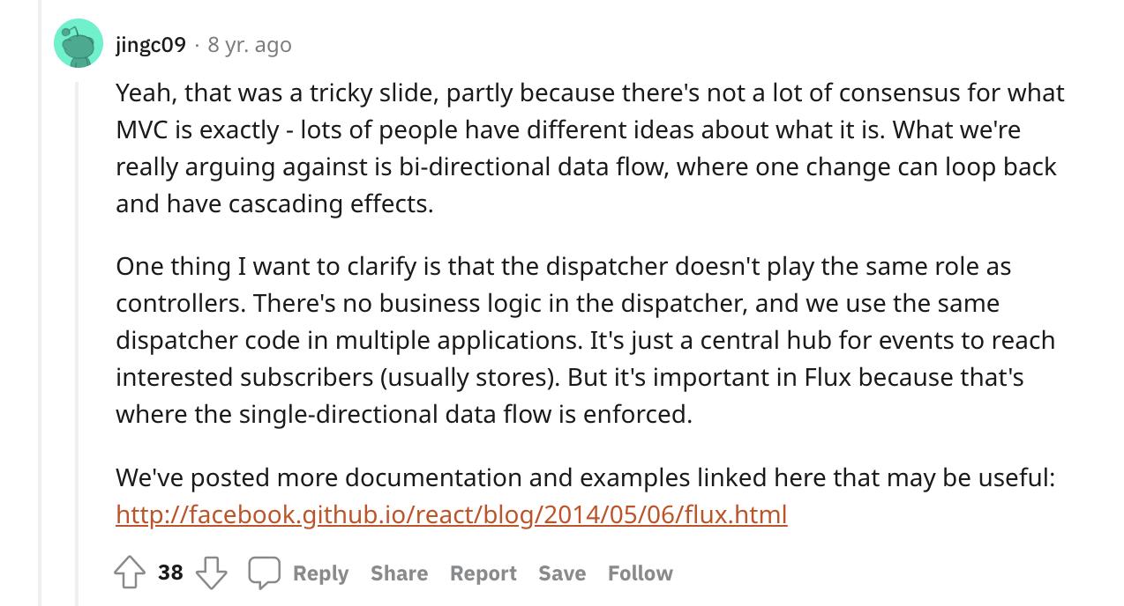

Slide 37
Should You Use Redux?​
Here are some suggestions on when it makes sense to use Redux:
You have reasonable amounts of data changing over time
You need a single source of truth for your state
You find that keeping all your state in a top-level component is no longer sufficient

Slide 38
Thank
You!
Any questions?

Slide 39
Resources
https://www.youtube.com/watch?v=nYkdrAPrdcw
https://www.martinfowler.com/eaaDev/uiArchs.html#Model-view-presentermvp
http://ceur-ws.org/Vol-610/paper11.pdf
https://www.infoq.com/news/2014/05/facebook-mvc-flux/
https://www.reddit.com/r/programming/comments/25nrb5/comment/chj2fzc/
https://stackoverflow.com/questions/2056/what-are-mvp-and-mvc-and-what-is-the-difference
https://github.com/facebook/flux/tree/main/examples/flux-concepts
https://youtube.com/watch?v=xsSnOQynTHs
https://stackoverflow.com/questions/32461229/why-use-redux-over-facebook-flux

